Slide 1
Credential Management and AWS & Customer Managed Policies
Name
Institution of Affiliation

Slide 2
Credentials Management
Credentials management is an established form of software that is used for issuing and managing credentials.
Identity and Access Management (IAM) provide different ways of getting important things through the use of a token.
AWS is IAM services are build in a manner that allows you to get a security token which allow someone to perform requests against the many different APIs within the AWS.
Notes:
Credential Management is also a proposed application programming interface (API) under development by the World Wide Web Consortium for standardizing aspects of how password managers used by web user agents (web browsers and other applications) create, store, use, and modify username and password combinations for logins, in addition to the management of "federated” credentials (such as single sign-on tokens) by user agents.

Slide 3
Managing User Credentials
The key thing provided by the token is the identity of the person and the relative permission that the person have.
This is done by creation of assertion identifiers embedded in the token itself.
For one to get a token, he/she have to provide some credentials as part of the process.
If you are a user, you will be required to provide username and password.
Notes:
The key thing provided by the token is the identity of the person and the relative permission that the person have. This is done by creation of assertion identifiers embedded in the token itself. For one to get a token, he/she have to provide some credentials as part of the process. If you are a user, your will be required to provide username and password.

Slide 4
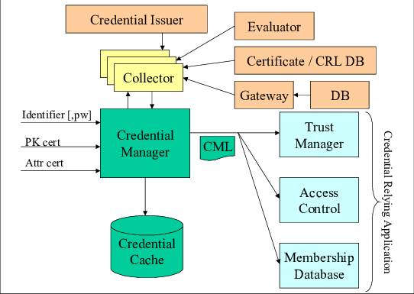

Notes:
Protocol for credential management.

Slide 5
Managing User Credentials Cont...
For one performing more programmatic interactions with AWS, one needs to use access and the secret access key which are an encrypted set of identifier information.
The access and secret key provide input on your identity and the relative permission you have by referring to some collective assertion IDs.
There are also things like the X.S509 request signing certificate. The certificate is attached to users and they are required to provide the right certificate on any request that they make.
One can have up to two access keys and have a discretion of making them active or inactive or even deleting them.
Notes:
The access and secret key provide input on your identity and the relative permission you have by referring to some collective assertion IDs. There are also things like the X.S509 request signing certificate. The certificate is attached to users and they are required to provide the right certificate on any request that they make. One can have up to two access keys and have a discretion of making them active or inactive or even deleting them.

Slide 6
AWS Managed Policy and Customer Managed Polices
The AWS identity and managed policies provide useful ways to control authorization.
The main issues is the who creates the policy and how it should be maintained over time.
For the AWS policy, the AWS creates the policy and maintains the policy over time.
When using the AWS policy, a new IPI automatically updates itself on the background which is not the case for the customer managed policies.
Notes:
AWS and managed policies have useful control and authorization. The main issues is the who creates the policy and how it should be maintained over time.
For the AWS policy, the AWS creates the policy and maintains the policy over time. When using the AWS policy, a new IPI automatically updates itself on the background which is not the case for the customer managed policies

Slide 7
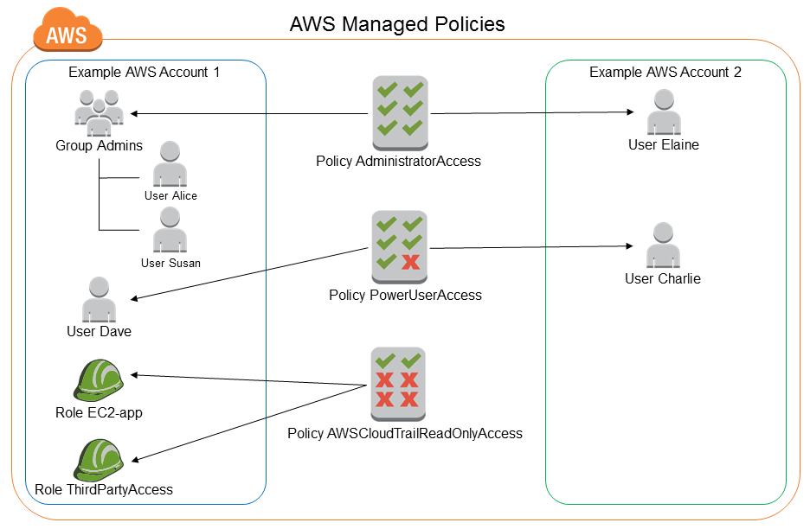
Notes:
Typical example of AWS-managed policies work.

Slide 8
Customer-managed Policy
The customer managed policy have two options namely Inline and Managed Policies.
An inline policy is a policy that you imbed inside a user group or rows and is restricted to only using it in one identity.
Managed Policy has a policy object that you can attach to multiple groups or multiple rows and is a re-usable type of policy.
Notes:
The big question is who creates the policy and how we should maintain them over time. One of the ways is Customer managed policy which have two flavors: Inline and managed policies. An inline policy is a policy that you imbed inside a user group or rows and is restricted to only using it in one identity.

Slide 9
Cont...
Inline management give us important mechanism but they are limited in that they are not reusable and their identity is specific. This makes it to have a high administrative costs potentially leveraging them in maintaining them over time.
The main question when it comes to the two policies is control.
The customer managed policy have a significant amount of control while the AWS policy is managed and controlled over time.
The main limitation when it comes to use of customer managed is the requirement to add every new command.
Notes:
. Managed Policy has a policy object that you can attach to multiple groups or multiple rows and is a re-usable type of policy. Inline management give us important mechanism but they are limited in that they are not reusable and their identity is specific. This makes it to have a high administrative costs potentially leveraging them in maintaining them over time.

Slide 10
Cont...
The different types of policies are for different use cases. In most cases, it is recommended that you use managed policies instead of inline policies.
This is because managed policies provide us with the following features :
  Reusability - A single managed policy can be attached to multiple principal entities (users, groups, and roles).
  Central change management - When you change a managed policy, the change is applied to all principal entities that the policy is attached to. For example, if you want to add permission for a new AWS API, you can update the managed policy to add the permission.
Notes:
The different types of policies are for different use cases. In most cases, we recommend that you use managed policies instead of inline policies.

Slide 11
Cont…
Managed policies also provide delegating permission and management. You can allow users in your AWS account to attach and detach policies while maintaining control over the permissions defined in those policies. Some came be full time with unrestricted authority to create and delete policies while others have limited authority.
It also have automatic updates for AWS managed policies. AWS maintains AWS managed policies and updates them when necessary without you having to make changes. The updates are automatically applied to the principal entities that you have attached the AWS managed policy to.
Notes:
You can allow users in your AWS account to attach and detach policies while maintaining control over the permissions defined in those policies. In effect, you can designate some users as full administrators—that is, administrators that can create, update, and delete policies. You can then designate other users as limited administrators. That is, administrators that can attach policies to other principal entities, but only the policies that you have allowed them to attach. AWS maintains AWS managed policies and updates them when necessary (for example, to add permissions for new AWS services), without you having to make changes. The updates are automatically applied to the principal entities that you have attached the AWS managed policy to.

Slide 12
End
Inline policies are useful if you want to maintain a strict one-to-one relationship between a policy and the identity that it's applied to.
When you use an inline policy, the permissions in the policy cannot be inadvertently attached to the wrong identity.
In addition, when you use the AWS Management Console to delete that identity, the policies embedded in the identity are deleted as well. That's because they are part of the principal entity.
Notes:
Inline policies are useful if you want to maintain a strict one-to-one relationship between a policy and the identity that it's applied to. For example, you want to be sure that the permissions in a policy are not inadvertently assigned to an identity other than the one they're intended for. When you use an inline policy, the permissions in the policy cannot be inadvertently attached to the wrong identity. In addition, when you use the AWS Management Console to delete that identity, the policies embedded in the identity are deleted as well. That's because they are part of the principal entity.

Slide 13
References
Castle, B. (2019, September). User Credentials - 1-minute IAM - Amazon Web Services. Retrieved from https://www.youtube.com/watch?v=OZsmKaIz_M0&feature=youtu.be
Castle, B. (2019, October). Inline vs Managed Policies - 1-minute IAM - Amazon Web Services. Retrieved from https://www.youtube.com/watch?v=s2K-UYwLhoc&feature=youtu.be

